Slide 1

DAYANANDA SAGAR UNIVERSITY
SCHOOL OF ENGINEERING
Department of Computer Science and Engineering
Special Topic-II Review 1
HOUSE PRICE PREDICTION USING MACHINE LEARNING
Under the Supervision
Dr. Bondu Venkateswarlu
Presented By:
Daniel Thomas(ENG20CS0079)
Darshan S(ENG20CS0082)
Vivek Belagali (ENG20CS0414)
Viswanth Reddy(ENG20CS0095)
Notes:
Title of the project
CSE Dept., SET-Jain University
‹#›

Slide 2
Overview
Abstract
Problem Statement
Introduction
State of the Art work (Literature survey)
Design
Methodology
References
*
Dept of CSE., SOE-Dayananda Sagar University
‹#› of 12

Slide 3
Abstract
The current systems main disadvantage is that the calculation of house prices are done without the necessary prediction about future market trends and price increase.
The goal of the project is to predict the efficient house pricing for real estate customers with respect to their budgets and priorities.
In this project we try to implement prediction of future housing prices that is generated by machine learning algorithm.
The developer and customer will be benefited by this model on determining the selling price of a house and helps the latter to arrange the right time to purchase a house.
*
Dept of CSE., SOE-Dayananda Sagar University
‹#› of 12

Slide 4
Problem Statement
The buyers are just not concerned only about the size(square feet) of the house but there are various other factors that play a key role to decide the price of a house/property.
The statement is to develop a model that help in prediction of house prices by taking various factors into consideration.
Eg:
  Problem: The client needs help in analysing the house prices based on his requirements.
  Solution: Using ML algorithms we train datasets of various factors affecting the price of the house, then achieve the optimal prediction.
*
Dept of CSE., SOE-Dayananda Sagar University
‹#› of 12

Slide 5
Introduction
In this project, the house price prediction of the house is done using different Machine Learning algorithms like Random Forest Regression, Ridge Regression, LASSO Regression, Decision Tree Regression, XGBoost Regression.
We use Ada-Boost algorithm for boosting up the weak learners to strong learners.
This work applies various techniques such as variance influence factor, dimensionality reduction techniques and data transformation techniques such as outliers and missing value treatment.
Several factors that are affecting the house price includes the physical attributes, location as well as several economic factors persuading at that time.
*
Dept of CSE., SOE-Dayananda Sagar University
‹#› of 12

Slide 6
State of the Art-work
Author’s Name/ Paper Title | Conference/Journal Name and year | Technology/ Design | Results shared by author | What you infer
House Price Prediction/Prof. Bindu Shivashankar | International Journal of Computer Sciences and Engineering/July 2020 | Ridge regression, Lasso regression, XGBoost regression | RMSE as 0.12 | Performance calculation using RMSE scores.
House Price Prediction Using Machine Learning/ Dr. G Naga Sathish | International Journal of Innovative Technology and Exploring Engineering/July 2019 | Linear regression, Multiple regression analysis | Gradient Boosting Regressor accuracy = 91.272 | Implementation of Gradient Boosting Algorithm.
House Price Prediction Using Machine Learning/Dr. Vinayk A.Bharadi | IRE Journals/ May 2021 | Decisive tree, K-means, Random Forest | Random Forest Algorithm SD = 0.762 | Implementation of Linear Regression and Random Forest Algorithm.
*
Dept of CSE., SOE-Dayananda Sagar University
‹#› of 12

Slide 7
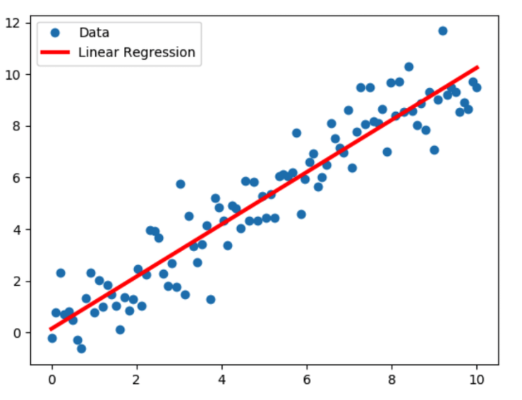
Design
Our project is based on Multiple Linear Regression Algorithm.
Linear Regression is a Supervised Machine Learning Model for finding the relationship between independent variables and dependent variable. It performs the task to predict the response (dependent) variable value (y) based on a given (independent) explanatory variable (x). So, this regression technique finds out a linear relationship between x (input) and y (output).
*
Dept of CSE., SOE-Dayananda Sagar University
‹#› of 12

Slide 8
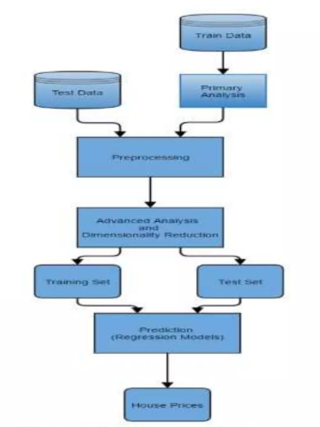
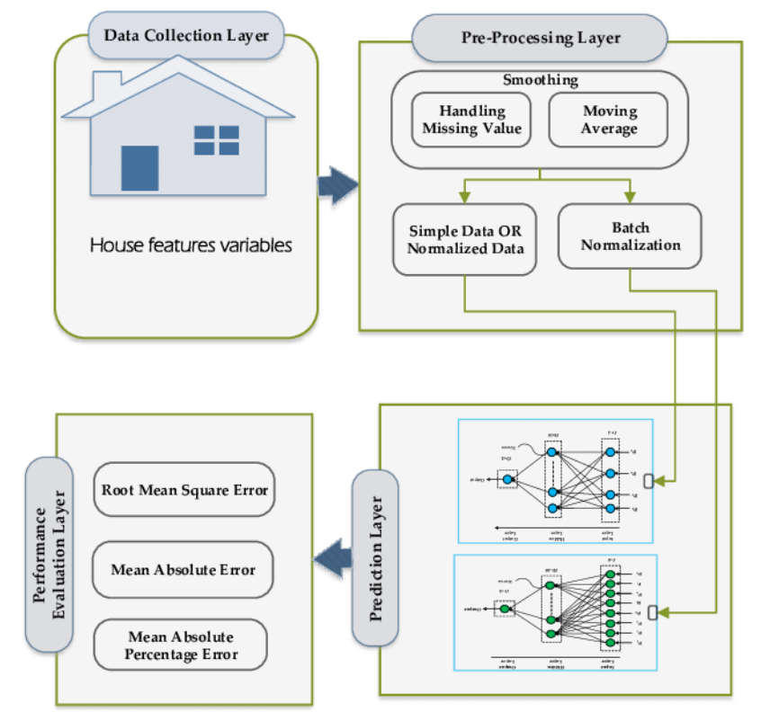
Design
*
Dept of CSE., SOE-Dayananda Sagar University
‹#› of 12

Slide 9
Methodology
Collecting Data: First step was to collect the data, we collected them from different sources and merged them together to from our training data set.
Then we train the model using Machine learning algorithm.
In our project we are using Multiple Linear Regression.
Based on the generated graphs we predict the cost of the house.
Our Data set was collected from Kaggle.com.
*
‹#› of 12
Dept of CSE., SOE-Dayananda Sagar University

Slide 10
References
House Price Prediction Using Machine Learning|G. Naga Satish, Ch. V. Raghavendran, M.D.Sugnana Rao, Ch.Srinivasulu|International Journal of Innovative Technology and Exploring Engineering (IJITEE) ISSN: 2278-3075, Volume-8 Issue-9, July 2019
House Price Prediction|Bindu Sivasankar1, Arun P. Ashok2, Gouri Madhu3 , Fousiya S.|International Journal of Computer Sciences and EngineeringVol.8, Issue.7, July 2020 E-ISSN: 2347-2693
House Price Prediction Using Machine Learning|Anand G.Rawool, Dattatray V.Rogye, Sainath G.Rane, Dr. Vinayk A.Bharadi|IRE Journals , Volume 4 Issue 11, MAY 2021
*
Dept of CSE., SOE-Dayananda Sagar University
‹#› of 12

Slide 11
THANK YOU
*
Dept of CSE., SOE-Dayananda Sagar University
(#) of 12

